Slide 1
BIG Mountain REsort

Slide 2
With incredible views of Flathead National Forest and Glacier National Park, Big Mountain Ski Resort is situated in Montana. 11 lifts, 2 T-bars, and 1 magic carpet with a 3.3-mile longest stretch serve the resort. Skiers and riders of all levels and abilities can access the longest run as well as beginner slopes. The objective is to generate a profit during the upcoming skiing season by correctly pricing tickets to cover the additional running expenses of $1,540,000 resulting from the additional chair lift installation.

Slide 3
GOALS
With additional facility available, attract more skiers and riders than the 350k from the previous year.
Set the ticket price as profitably as possible while still covering the additional $1540000 running expenses.

Slide 4
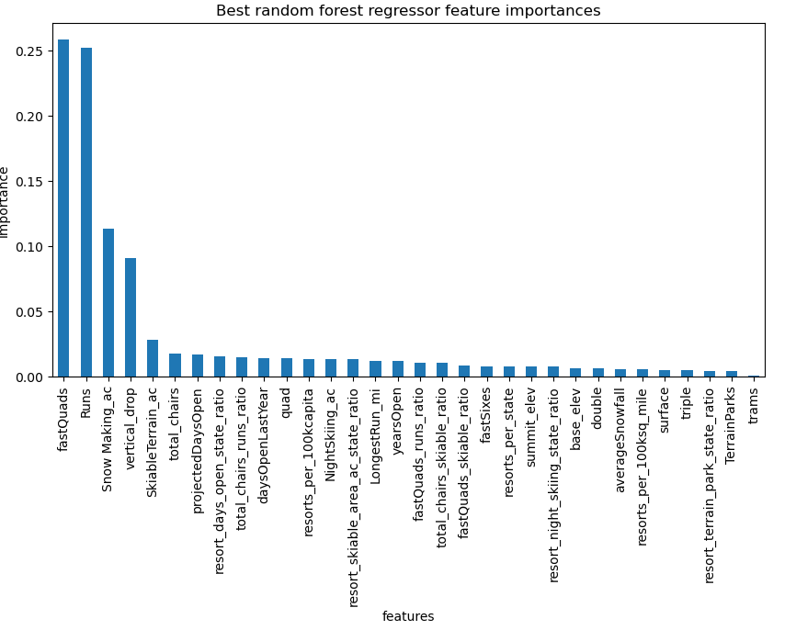
Big Mountain resort stands out in terms of
total_chairs, FastQuads, Runs, and longestRun skiable terrain,

Slide 5
Random Forest Predictive Model Results:
Closing down runs affects the revenue
Adding more runs and chairs and raising the vertical drop by 150 feet support the $1.99 increase in ticket price.
Increasing in number of Runs, vertical_drop, total_chairs and guaranteed snow also supports the ticket price increase by $1.99 and will generate $347,4638 more in revenue
Increasing longest run by .2 miles and guaranteed snow coverage by 4 acres makes no difference to price

Slide 6
SUMMARY
The following attributes were crucial for determining ticket prices:
vertical_drop, Snow_making_ac, total_chairs, fastQuads, and Runs
With 4 options short listed by Business, second option of increasing
vertical drop looks more promising as additional chair lifts have
been added.
Additional operating cost of chairs is known but adding vertical drop operating cost needs to included in the final operating cost.

